Slide 1
UNIT- II
Decentralization and Cryptography Technical Foundations
20CSE15- BLOCKCHAIN TECHNOLOGIES

Slide 2
Cryptography Technical Foundations
Introduction - Cryptography- Confidentiality - Integrity – Authentication - Cryptographic primitives - Asymmetric cryptography - Public and private keys – RSA -Discrete logarithm problem - Hash functions - Elliptic Curve Digital signature algorithm

Slide 3
Introduction
Set
A set is a collection of distinct objects, for example, X = {1, 2, 3, 4, 5}.
Group
A group is a commutative set with one operation that combines two elements of the set.
Closure (closed) means that if, for example, elements A and B are in the set, then the resultant element after performing an operation on the elements is also in the set.
Associative means that the grouping of elements does not affect the result of the operation.

Slide 4
If G is a non-empty set and “⋆” is the binary operation defined on G such that the following laws or axioms are satisfied then, (G, ⋆) is called a group.
(G1) – Closure law
for a, b ∈ G, a ⋆ b ∈ G
(G2) – Associative law
a ⋆ (b ⋆ c) = (a ⋆ b) ⋆ c for all a, b, c ∈ G

Slide 5
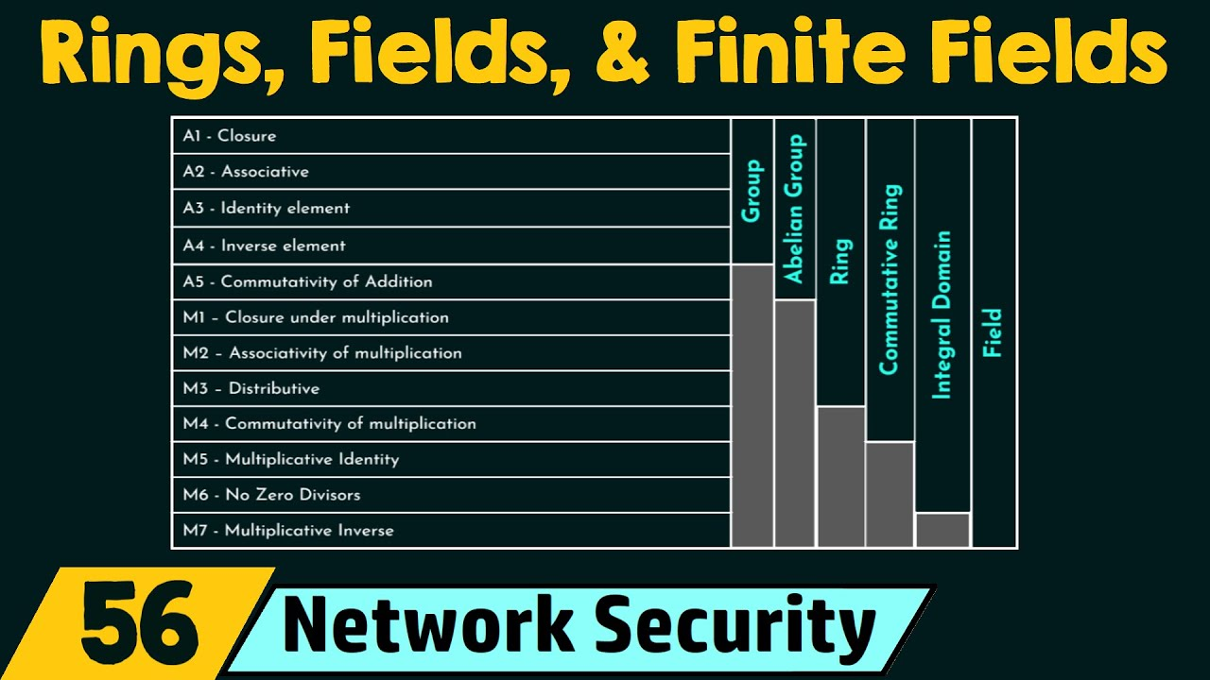

Slide 6
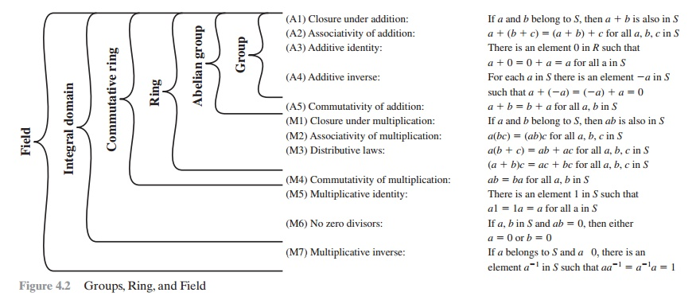

Slide 7
An abelian group
An abelian group is formed when the operation on the elements of a set is commutative.
The commutative law means that changing the order of the elements does not affect the result of the operation, for example, A X B = B X A.

Slide 8
Ring
If more than one operation can be defined over an abelian group, that group becomes a ring.
There are also specific properties that need to be satisfied.
A ring must have closure and associative and distributive properties.

Slide 9
Field
A field is a set in which all elements in the set form an additive and multiplicative group.
For all group operations, the distributive law is also applied. The law dictates that the same sum or product will be produced even if any of the terms or factors are reordered.

Slide 10
A finite field
A finite field is one with a finite set of elements.
Also known as Galois fields, they can be used to produce accurate and error-free results of arithmetic operations.
For example, prime finite fields are used in Elliptic Curve Cryptography (ECC) to construct discrete logarithm problems.
Order
The order is the number of elements in a field. It is also known as the cardinality of the field.

Slide 11
Prime fields
A prime field is a finite one with a prime number of elements.
It has specific rules for addition and multiplication, and each nonzero element in the field has an inverse.
no proper subfield
A cyclic group
A cyclic group is a type of group that can be generated by a single element called the group generator.

Slide 12
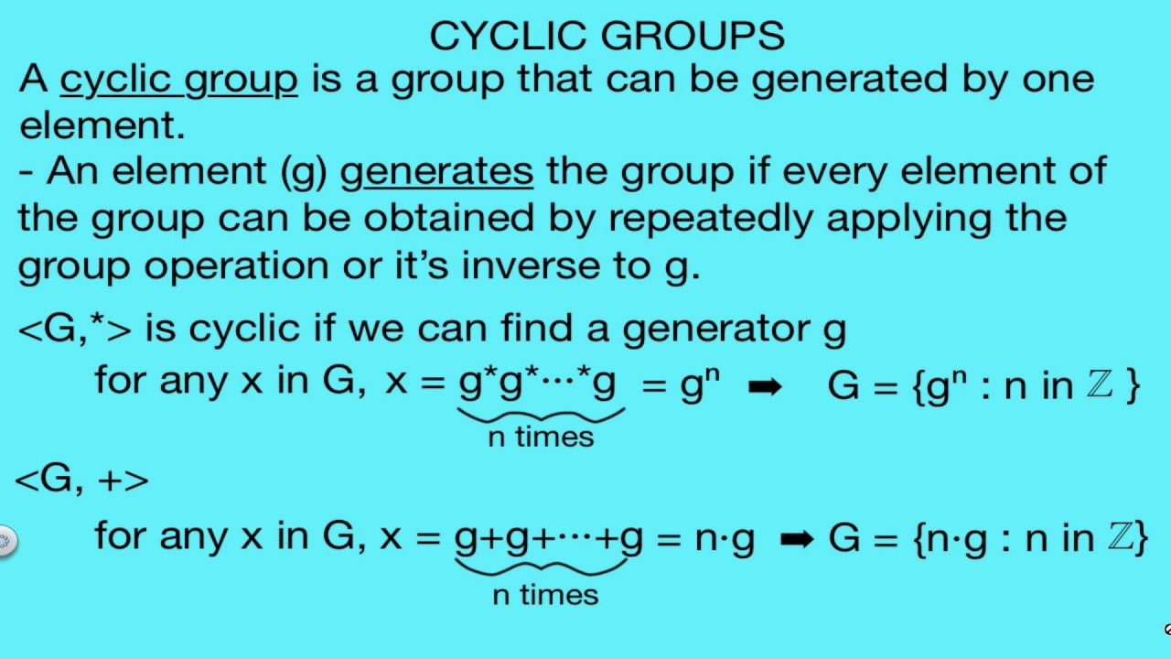

Slide 13
Cryptography
Cryptography is a method of protecting information and communications through the use of codes, so that only those for whom the information is intended can read and process it.

Slide 14
Cryptography
Entity: Either a person or system that sends, receives, or performs operations on data
Sender: This is an entity that transmits the data
Receiver: This is an entity that takes delivery of the data
Adversary: This is an entity that tries to circumvent the security service
Key: A key is data that is used to encrypt or decrypt other data
Channel: Channel provides a medium of communication between entities

Slide 15
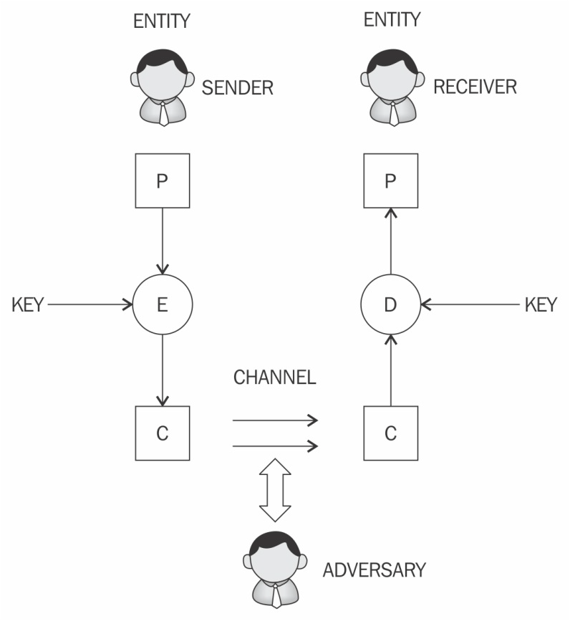

Slide 16
Confidentiality
Confidentiality is the assurance that information is only available to authorized entities.
Integrity
Integrity is the assurance that information is modifiable only by authorized entities.
Authentication
Authentication provides assurance about the identity of an entity or the validity of a message.
two types - entity authentication and data origin authentication

Slide 17
Entity authentication
assurance that an entity is currently involved and active in a communication session.
single-factor authentication- only one factor involved, namely, something you know, that is, the password and username
multi-factor authentication - multiple factors
something you have
something you know
something you are

Slide 18
Data origin authentication
message authentication -assurance that the source of the information is indeed verified
Various methods, such as Message Authentication Codes (MACs) and digital signatures are most commonly used

Slide 19
Non-repudiation
The creator/sender of the information cannot deny at a later stage their intentions in the creation or transmission of the information.

Slide 20
Cryptographic primitives
Cryptographic primitives are the basic building blocks of a security protocol or system.
A security protocol is a set of steps taken to achieve the required security goals by utilizing appropriate security mechanisms.

Slide 21
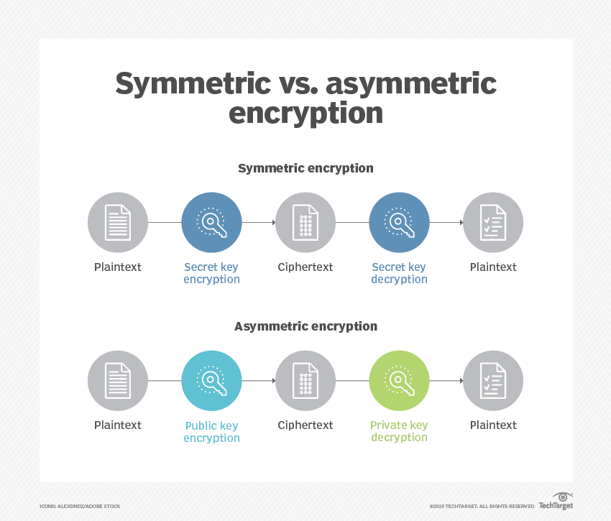

Slide 22
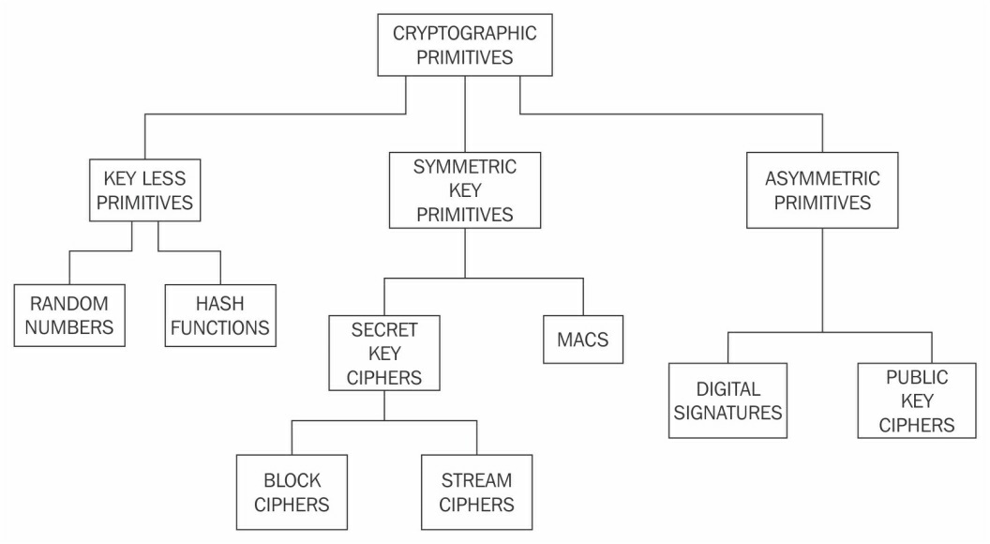

Slide 23
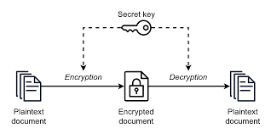
Symmetric cryptography/shared key cryptography/secret key cryptography.
Same key is used for encryption and decryption
key must be established or agreed upon before the data exchange occurs between the communicating parties.

Slide 24
Symmetric cryptography (Contd..)
Two types of symmetric ciphers: stream ciphers and block ciphers
Eg: block ciphers- Data Encryption Standard (DES) and Advanced Encryption Standard (AES), stream ciphers- RC4 and A5

Slide 25
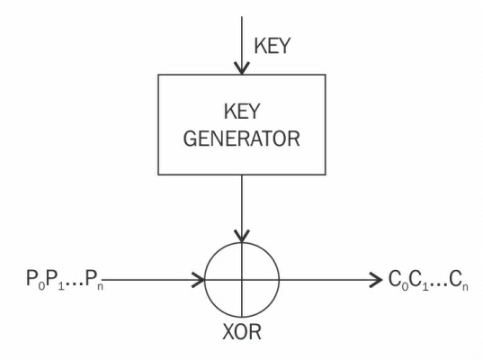
Stream ciphers
apply encryption algorithms on a bit-by-bit basis (one bit at a time) to plaintext using a keystream
Two types of stream ciphers
Synchronous stream ciphers- keystream is dependent only on the key, strict synchronization
Asynchronous stream ciphers- keystream is dependent on the encrypted data, Lack of strict synchronization - there may be delays or disruptions in the communication.

Slide 26
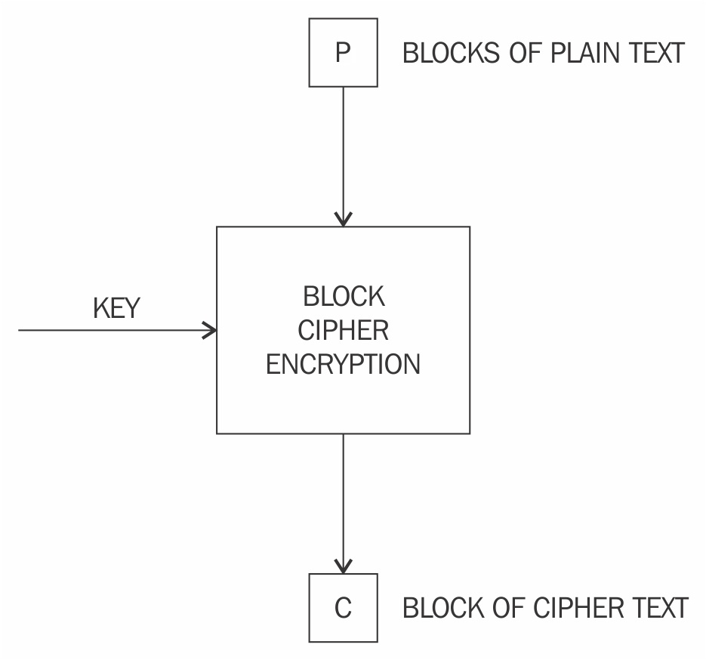
Block ciphers
break up the text to be encrypted (plaintext) into blocks of a fixed length and apply the encryption block-by-block
generally built using a design strategy known as a Feistel cipher
Recent block ciphers, have been built using a combination of substitution and permutation called a Substitution-Permutation Network (SPN)

Slide 27
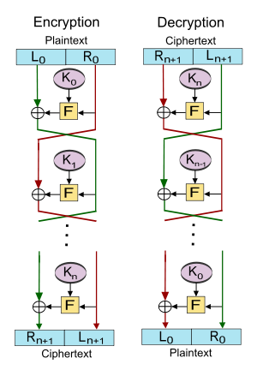
Feistel cipher
The Feistel cipher is a specific design structure used to construct symmetric block ciphers.
A key advantage of using a Feistel cipher is that encryption and decryption operations are almost identical and only require a reversal of the encryption process to achieve decryption.
DES is a prime example of Feistel-based ciphers:

Slide 28
Feistel cipher
Key Expansion: The secret encryption key is expanded into a set of round keys, one for each round of encryption.
Split and Concatenate: The plaintext block is split into two equal-sized parts, typically referred to as the left and right halves.
Round Function: The round function takes the current round's key as input and produces an output that is then XORed with the left half of the plaintext.
Swap: After the XOR operation, the left and right halves are swapped.
Repeat: The process of applying the round function and swapping the halves is repeated for a fixed number of rounds (typically 16 or 32) to create the final ciphertext.

Slide 29
Block encryption mode
the plaintext is divided into blocks of fixed length depending on the type of cipher used
the encryption function is applied to each block

Slide 30
Various modes of operation for block ciphers
modes are used to specify the way in which an encryption function is applied to the plaintext
Electronic Code Book (ECB)
Cipher Block Chaining (CBC)
Output Feedback (OFB) mode
Counter (CTR) mode

Slide 31
Electronic Code Book
basic mode of operation in which the encrypted data is produced by applying the encryption algorithm one-by-one to each block of plaintext.
most straightforward mode
not be used in practice as it is insecure and can reveal information

Slide 32
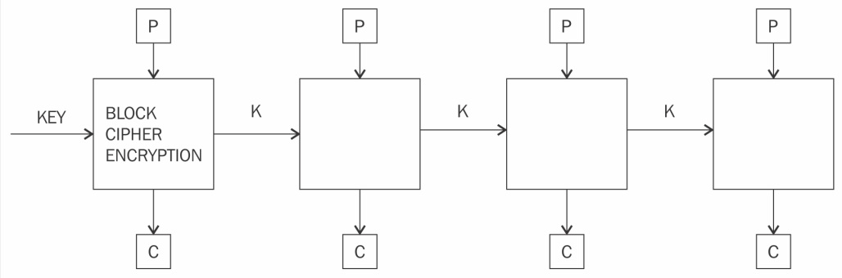
Electronic Code Book

Slide 33
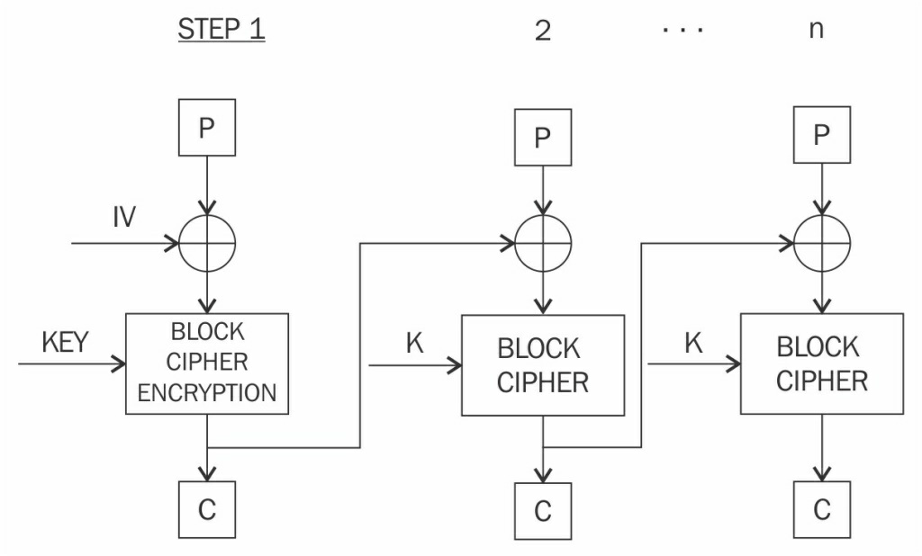
Cipher Block Chaining

Slide 34
Cipher Block Chaining
In Cipher Block Chaining (CBC) mode, each block of plaintext is XOR'd with the previously-encrypted block.
CBC mode uses the Initialization Vector (IV) to encrypt the first block.
It is recommended that the IV be randomly chosen.

Slide 35
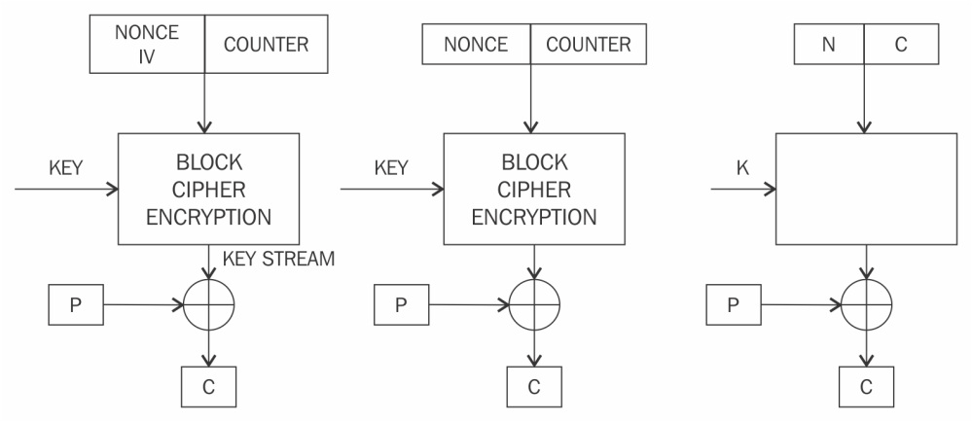
Counter mode

Slide 36
Counter mode
The Counter (CTR) mode effectively uses a block cipher as a stream cipher.
In this case, a unique nonce is supplied that is concatenated with the counter value to produce a keystream

Slide 37
Keystream generation mode
the encryption function generates a keystream that is then XOR'd with the
plaintext stream to achieve encryption.

Slide 38
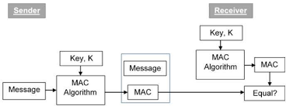
Message authentication mode
MAC is a cryptographic checksum that provides an integrity service.
common method to generate a MAC using block ciphers is CBC-MAC, where a part of the last block of the chain is used as a MAC

Slide 39
Cryptographic hash mode
Hash functions are primarily used to compress a message to a fixed-length digest.
In cryptographic hash mode, block ciphers are used as a compression function to produce a hash of plaintext.

Slide 40
Data Encryption Standard
introduced by the U.S. National Institute of Standards and Technology (NIST) as a standard algorithm for encryption, and it was in widespread use during the 1980s and 1990s.
not very resistant to brute force attacks
DES uses a key of only 56 bits and this problem was addressed with the introduction of Triple DES (3DES), which proposed the use of a 168-bit key by means of three 56-bit keys and the same number of executions of the DES algorithm, thus making brute force attacks almost impossible.
limitations- slow performance and 64-bit block size

Slide 41
Advanced Encryption Standard
The Advanced Encryption Standard (AES) is a widely used symmetric encryption algorithm and one of the most secure cryptographic standards.
It was selected as the official encryption algorithm by the U.S. National Institute of Standards and Technology (NIST) in 2001 after a public competition to replace the aging Data Encryption Standard (DES).
AES operates on fixed-size blocks of data, and the standard defines three key sizes: AES-128, AES-192, and AES-256. These key sizes correspond to 128-bit, 192-bit, and 256-bit keys, respectively

Slide 42
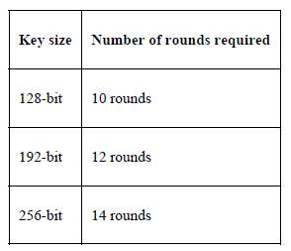
Advanced Encryption Standard
During AES algorithm processing, a 4 x 4 array of bytes known as the state is modified using multiple rounds.
Full encryption requires 10 to 14 rounds, depending on the size of the key.

Slide 43
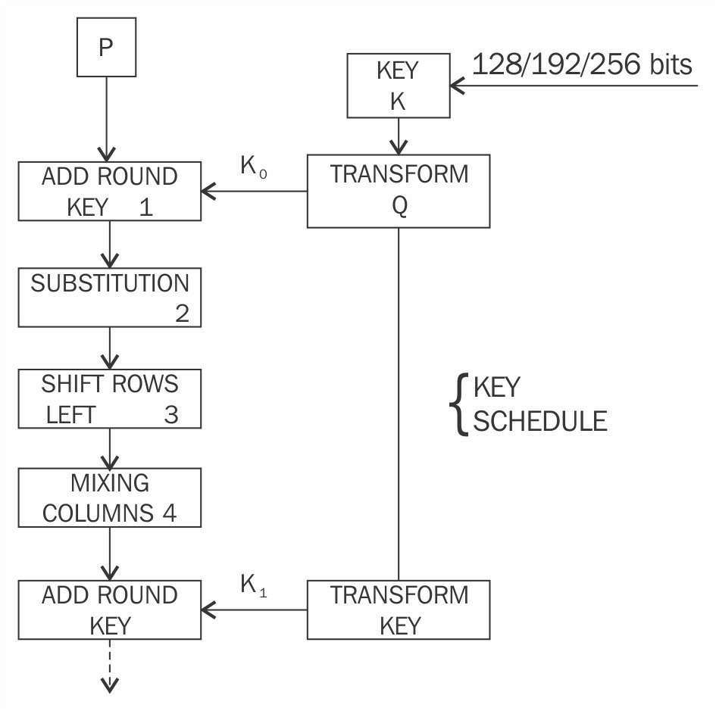
Advanced Encryption Standard

Slide 44
Once the state is initialized with the input to the cipher, four operations are performed in four stages to encrypt the input.
1. In the AddRoundKey step, the state array is XOR'd with a subkey, which is derived from the master key
2. SubBytes is the substitution step where a lookup table (S-box) is used to replace all bytes of the state array
3. The ShiftRows step is used to shift each row to the left, except for the first one, in the state array to the left in a cyclic and incremental manner
4. Finally, all bytes are mixed in the MixColumns step in a linear fashion, column-wise

Slide 45
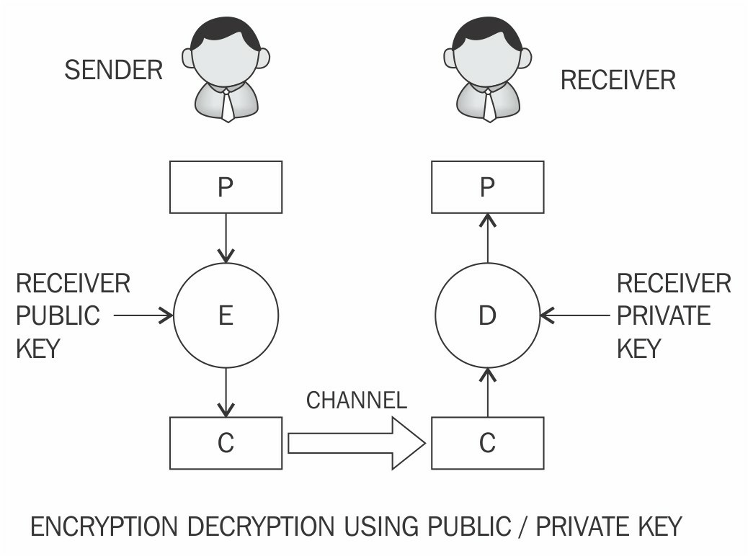
Asymmetric cryptography/ public key cryptography
the key that is used to encrypt the data is different from the key that is used to decrypt the data.
It uses both public and private keys to encrypt and decrypt data, respectively.
Various asymmetric cryptography schemes are in use, including RSA, DSA, and ElGammal

Slide 46
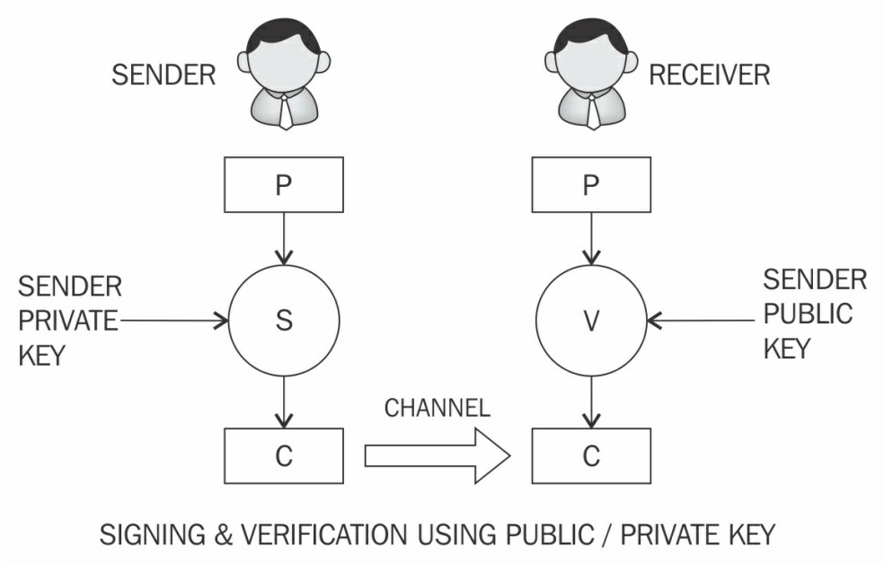

Slide 47
Integer factorization
Integer factorization schemes are based on the fact that large integers are very hard to factor (the multiplication of two large prime numbers is easy, but it is difficult to factor it (the result of multiplication,product) )back to the two original numbers.
RSA uses Integer factorization

Slide 48

Discrete logarithm
A discrete logarithm scheme is based on a problem in modular arithmetic.
It is easy to calculate the result of modulo function, but it is computationally impractical to find the exponent of the generator.
This difficult problem is commonly used in the Diffie-Hellman key exchange and digital signature algorithms.

Slide 49
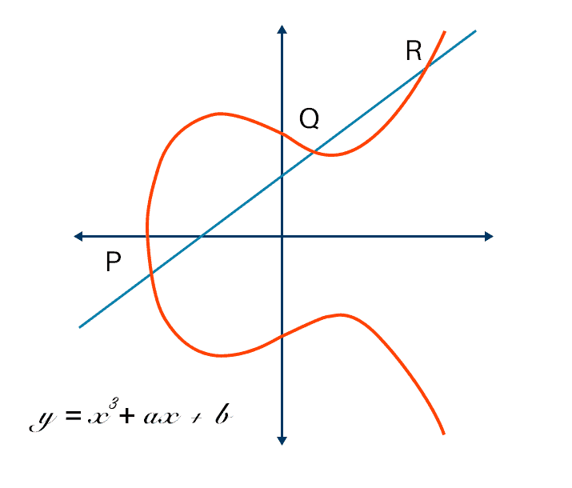
Elliptic curves
algebraic cubic curve over a field
prominently used cryptosystems based on elliptic curves are the Elliptic Curve Digital Signature Algorithm (ECDSA) and the Elliptic Curve Diffie-Hellman (ECDH) key exchange.

Slide 50
Private key
randomly generated number that is kept secret and held privately by its users
need to be protected and no unauthorized access should be granted to that key
Public key
A public key is freely available and published by the private key owner
Anyone who would then like to send the publisher of the public key an encrypted message can do so by encrypting the message using the published public key and sending it to the holder of the private key

Slide 51
RSA
RSA was invented in 1977 by Ron Rivest, Adi Shamir, and Leonard Adelman, hence the name Rivest–Shamir– Adleman (RSA).
based on the integer factorization problem

Slide 52
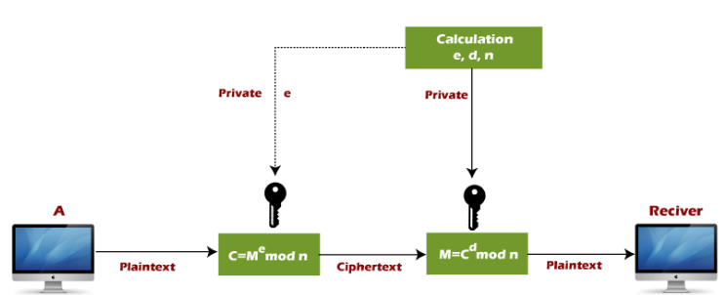

Slide 53
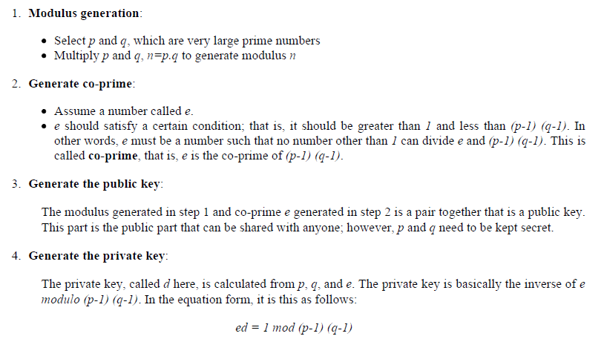

Slide 54
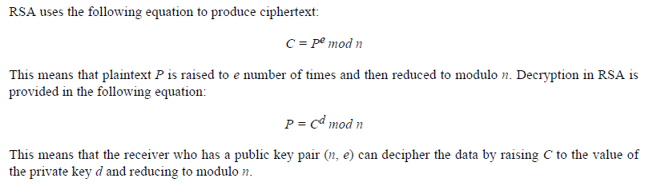
Encryption and decryption using RSA
https://drive.google.com/file/d/1Ss4Abi8FcttVI3f-JR0r_W2FWLpUmHUi/view?usp=drive_link
PROBLEM
https://www.javatpoint.com/rsa-encryption-algorithm

Slide 55
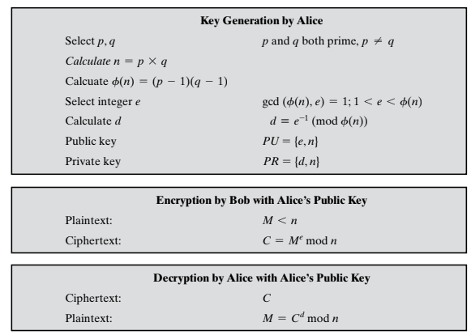
https://www.uobabylon.edu.iq/eprints/paper_1_17152_649.pdf

Slide 56
Elliptic Curve Cryptography
The key length for secure RSA use has increased over recent years, and this has put a heavier processing load on applications using RSA
A competing system challenges RSA: Elliptic Curve Cryptography (ECC)
The principal attraction of ECC, compared to RSA, is that it appears to offer
equal security for a far smaller key size, thereby reducing processing overhead
ECC is commonly used for key exchange and digital signatures

Slide 57
Elliptic curves are not ellipses. They are so named because they are described by
cubic equations, similar to those used for calculating the circumference of an ellipse.
In general, cubic equations for elliptic curves take the following form, known as a
Weierstrass equation:
ECC operates over a finite field, meaning the coordinates of points on the curve are taken from a finite set of numbers.
Such equations are said to be cubic, or of degree 3, because the highest exponent they contain is a 3.

Slide 58

An elliptic curve is defined in the following equation:
A and B belong to a finite field Zp or Fp (prime finite field) along with a special value called the point of infinity.
The point of infinity (∞) is used to provide identity operations for points on the curve

Slide 59

A condition also needs to be met that ensures that the curve is non-singular
To construct the discrete logarithm problem based on elliptic curves, a large enough cyclic group is required.
First, the group elements are identified as a set of points that satisfy the previous equation.
After this, group operations need to be defined on these points.

Slide 60
Group operations on elliptic curves
Point addition - process where two different points are added
Point doubling - the same point is added to itself

Slide 61
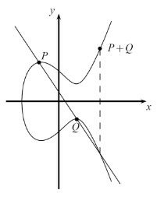
Point addition
a diagonal line is drawn through the curve that intersects the curve at two points P and Q, as shown in the diagram, which yields a third point between the curve and the line
geometric representation of point addition on elliptic curves

Slide 62
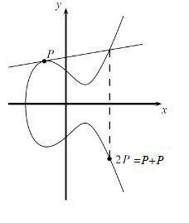
Point doubling
a tangent line is drawn through the curve and the second point is obtained, which is at the intersection of the tangent line drawn and the curve
Graph representing point doubling over real numbers

Slide 63
Discrete logarithm problem in ECC
under certain conditions, all points on an elliptic curve form a cyclic group

Slide 64
Hash functions
Create fixed-length digests of arbitrarily-long input strings
Commonly used for Digital Signatures and Message Authentication Codes
(MACs), such as HMACs
Three security properties
Preimage resistance
Second preimage resistance
Collision resistance

Slide 65
Practical Properties of Hash function
Compression of arbitrary messages into fixed-length digest
hash function must be able to take an input text of any length and output a
fixed-length compressed message.
Easy to compute
hash functions be very quick to compute regardless of the message size

Slide 66
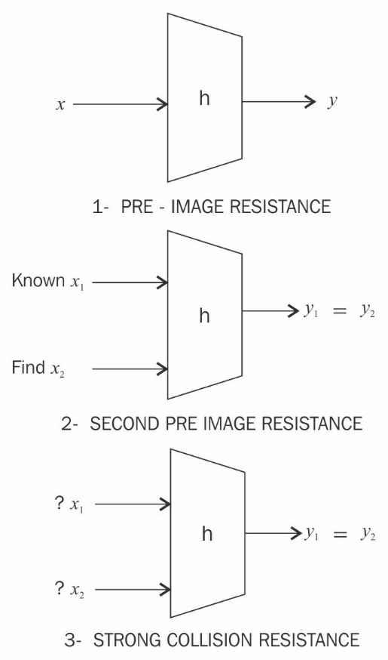
Preimage resistance/one-way property
h(x) = y
y cannot be reverse-computed to x
x is considered a preimage of y, hence the name preimage resistance
Second preimage resistance/ weak collision resistance
given x and h(x), it is almost impossible to find any other message m, where m != x and hash of m = hash of x or h(m) = h(x)

Slide 67
Collision resistance/ strong collision resistance
h(x) != h(z)
two different input messages should not hash to the same output

Slide 68
Multiple categories of hash functions
Message Digest
Secure Hash Algorithms- SHA-0, SHA-1,SHA-2,SHA-3, RIPEMD, Whirlpool

Slide 69
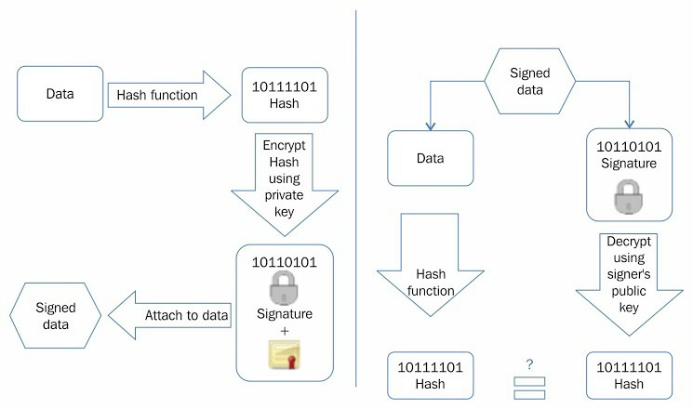
Digital signatures
Digital signatures are used in blockchain where the transactions are digitally signed by senders using their private key before broadcasting the transaction to the network.

Slide 70
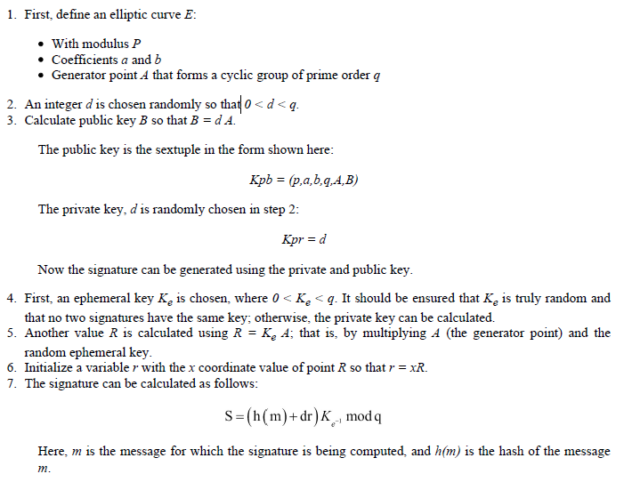
Elliptic Curve Digital Signature Algorithm
key pair needs to be generated

Slide 71
